Slide 1

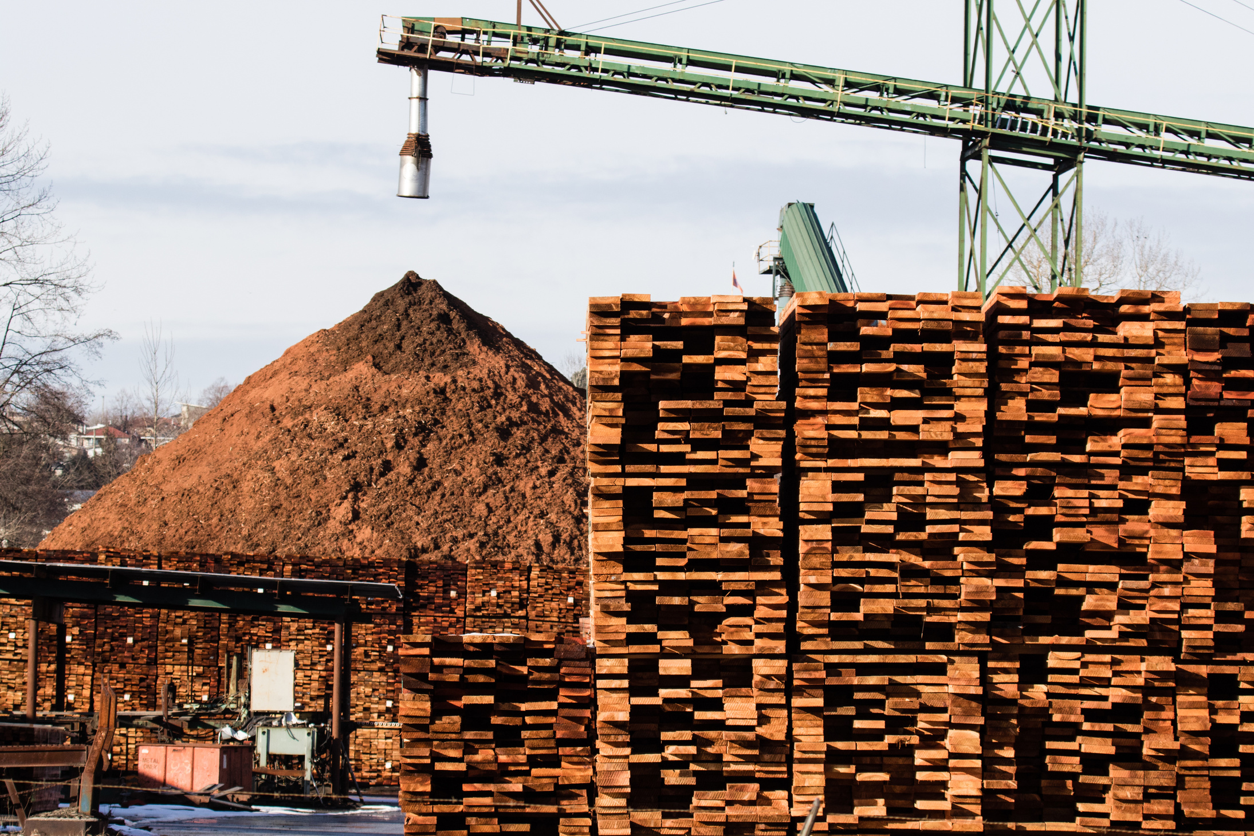

DR. MING CHEN
IS 610 BUSINESS DATA ANALYSIS
AGGREGATE PLANNING AT GREEN MILLS
DHRUTI DEDHIA
ADITYA RAVINDRA CHITNIS
PRIYANK PALSHETKAR
SAKSHI VIKAS JADHAV
ROSHNI RABINDRA SAHOO

Slide 2




Timeline
1
2
3
4
5
STAGE 1
STAGE 2
STAGE 3
STAGE 4
STAGE 5
Business Problem
Chase Strategy
Level Strategy
Optimal Strategy
Conclusion

Slide 3

Business Problem
OBJECTIVE
Minimize the total production cost by applying optimization techniques.
TASK
Develop a spreadsheet model to evaluate and compare the costs of three production strategies:
Chase Strategy: Produce exactly the forecasted demand each month using regular time production only, without relying on overtime or spot market purchases.
Level Strategy: Maintain a constant workforce of 20 employees, meet demand using regular capacity, and cover any shortfall with overtime or spot market purchases if necessary.
Optimal Strategy: Evaluate all possible variables, including hiring, layoffs, regular time, overtime, and spot market purchases, to identify the most cost-effective production approach.

Slide 4






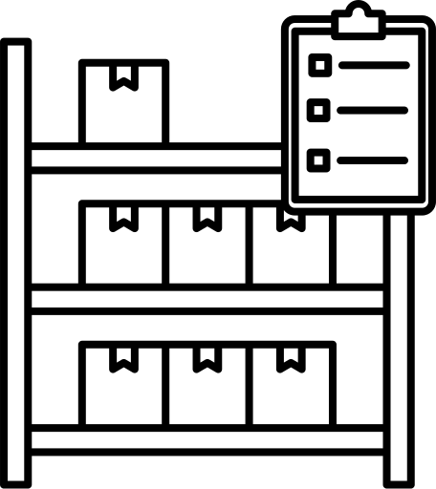

Challenges & Mitigation
Hiring and Laying Off Costs
Overtime Labor Cost
$4,000 and $2,000 per employee, respectively.
$250 per thousand board feet. (limited to 25% of normal working hours)
Regular Time Labor Cost
Spot Market Purchasing Cost
$200 per thousand board feet.
$400 per thousand board feet
Inventory Holding Costs
Shipping Cost
$25 per thousand board feet.
$50 per thousand board feet.

Slide 5



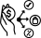


Predefined Conditions
Demand Data
Production Decisions
The demand for each month is provided.
Demand varies across months.
Production decisions are finalized at the start of each month to ensure efficient planning and execution.
Lead Time
Shipping Capacity
For the purpose of this analysis, the lead time for harvesting and shipping, which typically takes one month, is assumed to have no impact on production decisions.
To reduce the complexity of the calculations, shipping capacity has been excluded from the analysis, minimizing additional constraints.

Slide 6




Findings
Chase Strategy
Level Strategy
Optimal Strategy
This approach highlights the costs associated with hiring and shipping. The analysis emphasizes the need to align workforce and production plans with demand to manage costs efficiently. Focusing on regular hours instead of overtime, improving workforce management, and enhancing production processes can lead to cost reductions. Ongoing monitoring and adjustments will be crucial for maintaining long-term financial stability.
A fixed workforce may reduce hiring and layoff costs but could lead to higher overtime and spot market expenses. Inventory is efficiently managed, reducing excess stock and optimizing its use. The deliberate decrease in overtime employees at the year's end demonstrates a flexible workforce strategy. Spot market purchases play a major role during peak demand months, significantly impacting the overall annual costs.
The goal is to find a balance by factoring in all variables, offering opportunities for cost savings. It offers valuable insights into production and financial strategies, pinpointing areas for possible improvement and optimization. Ongoing monitoring and adjustments are crucial to ensure the strategy remains aligned with evolving market conditions and business performance

Slide 7
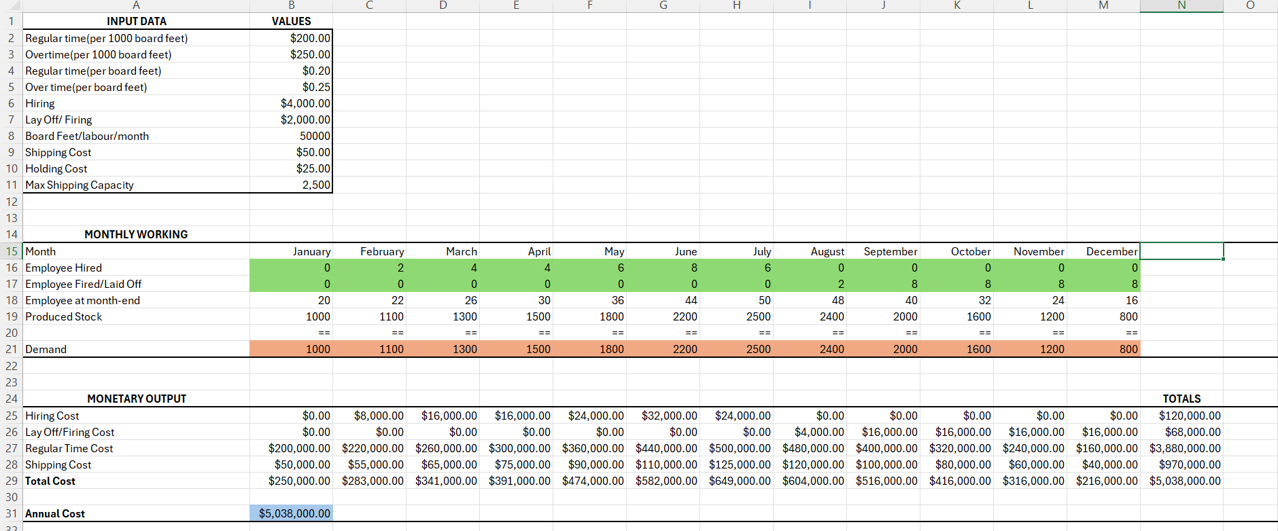
Chase Strategy

Slide 8
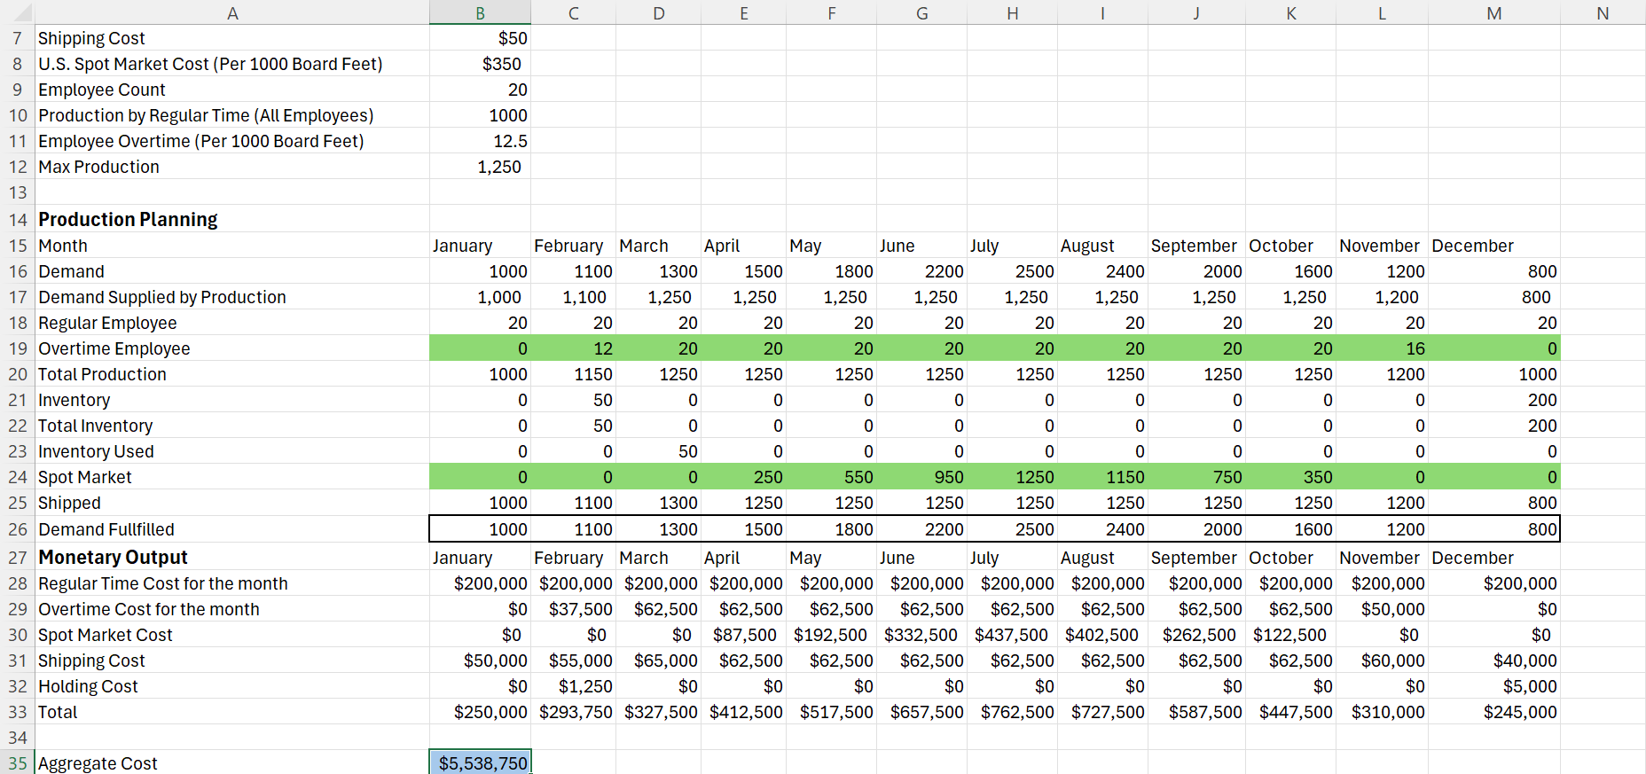
Level Strategy

Slide 9
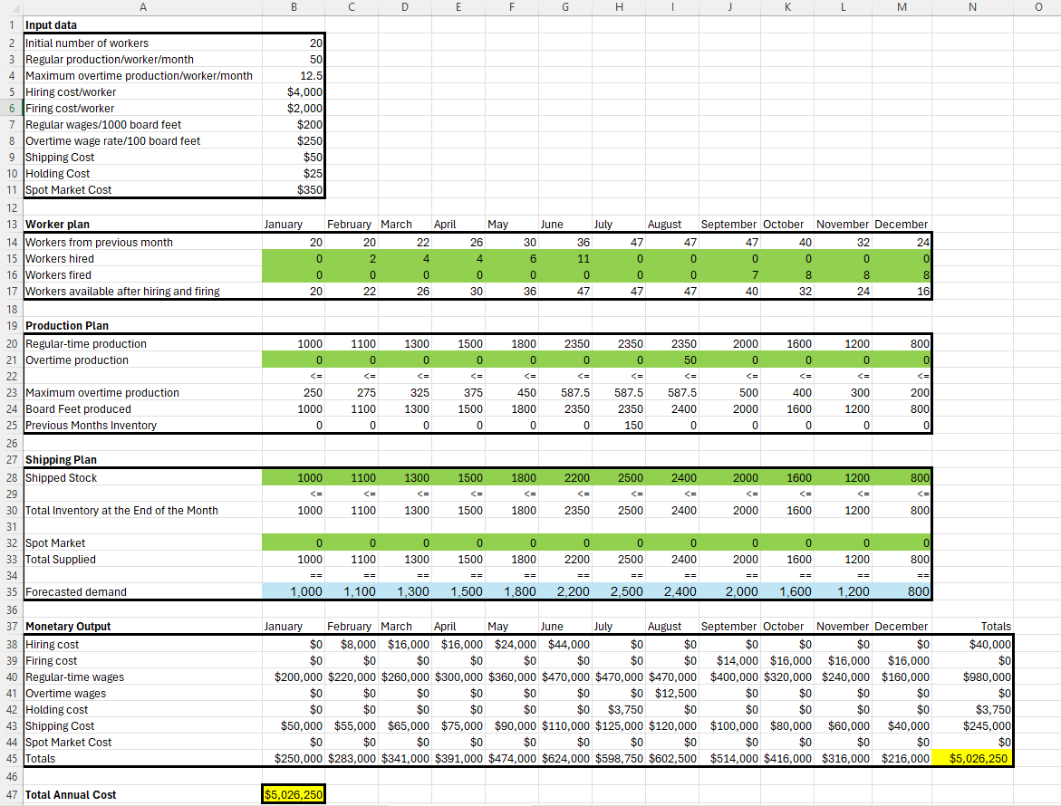
Optimal Strategy

Slide 10
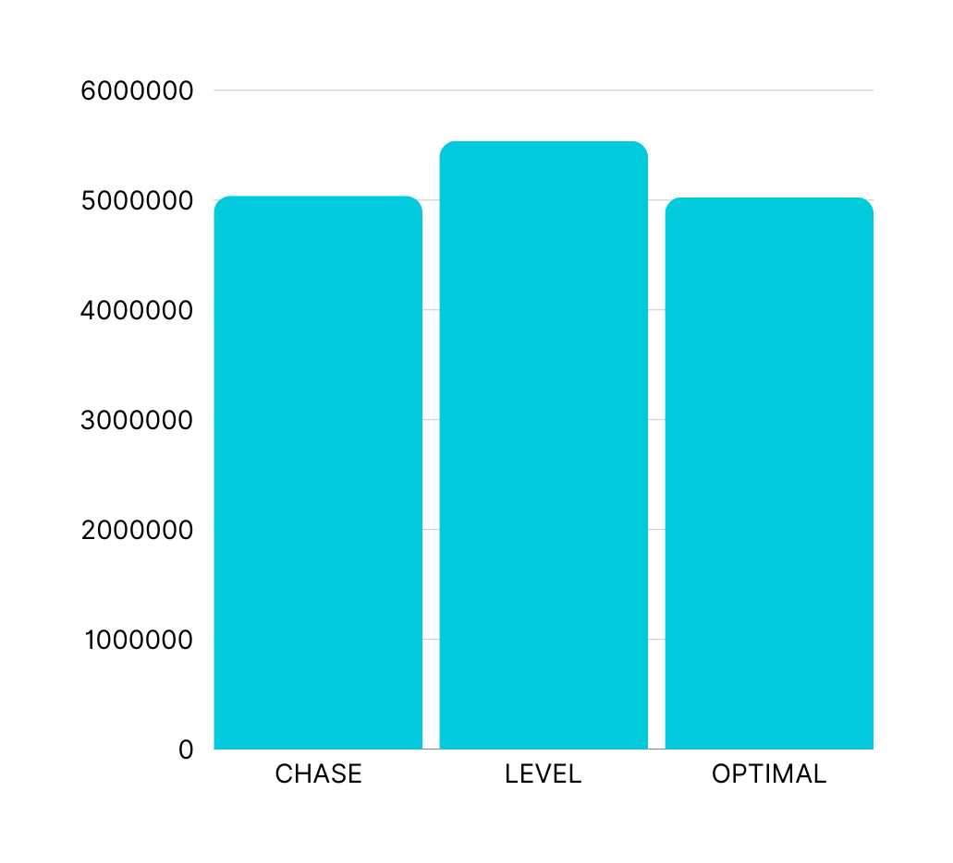
Analysis

Slide 11

OPTIMAL STRATEGY
HIRING COST: $40,000
FIRING COST: $62,000
REGULAR-TIME WAGES: $3,870,000
OVERTIME WAGES: $12,500
HOLDING COST: $3,750
SHIPPING COST: $970,000
SPOT MARKET COST: $0
TOTAL: $5,026,250
RECOMMENDED

Slide 12




Conclusion
Based on the analysis, we recommend minimizing spot market purchases to optimize costs and increase the distribution of own products in the market.
Our goal is to provide Green Mills with valuable insights that will support informed decision-making in response to fluctuating market demands.
The Excel spreadsheet provides a detailed cost breakdown for the optimal strategy, which will remain useful in the future, even with changes in market conditions and demand.

Slide 13

Thank You For Your Attention

